Slide 1
Face Reck
An attendance system using face recognition
By
Vijay P V

Slide 2
Objective
To make attendance system automated .
The use of face recognition as a method of authentication an identification for the student.

Slide 3
Working
The face encodings of each student is used as a unique reference of the student.
Once the face encoding of a student is recorded the concepts of 2-Dimentional rotations are used to create multiple possibilities of the face encoding to enhance the efficiency.
The attendance system accesses the webcam of a system to get the image of the student whose attendance must be marked
Once the student is identified the system enters the attendance onto a database along with he timestamp.

Slide 4
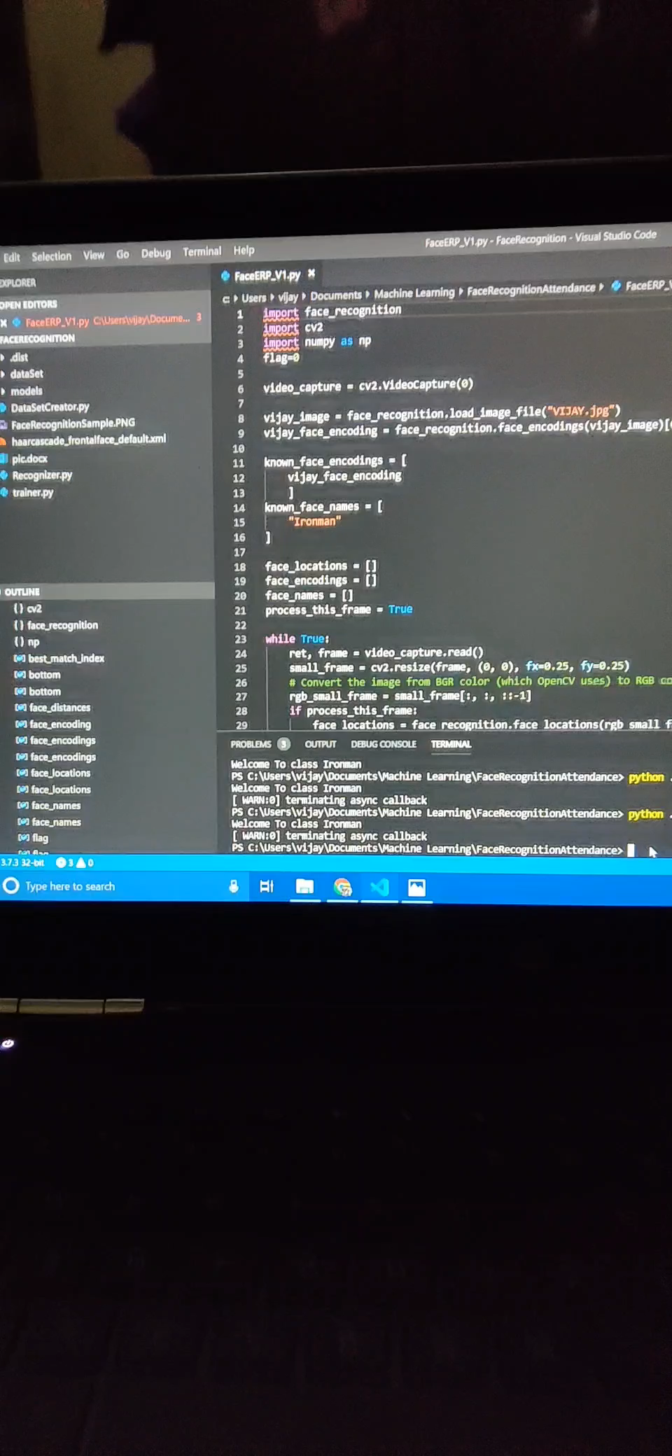
Demo

Slide 5
Advantages
Easy recording of student presence in the campus
Resistance to fraudulent presence
Reduces time complexity
High accuracy

Slide 6
Limitations
Efficiency is limited to the clarity of the handheld camera device

